Slide 1
Programming Fundamentals
Instructor : Jawad Hassan
jawad.hassan@nu.edu.pk
Fall-2022
November 24, 2022

Slide 2
File Handling
A file is a collection of data that is usually stored on a computer s disk. Data can be saved to les and then later reused.
Word Processors
Database Management Systems
Spreadsheets
Compilers
Image, video, audio, browser and other entertainment applications
Scientific and healthcare applications

Slide 3
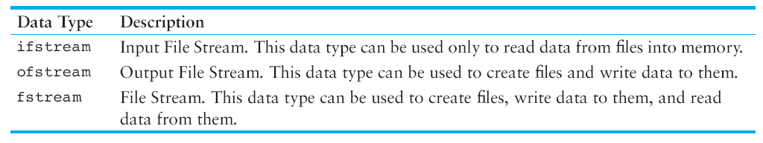
Fstream
Ofstream
Ifstream

Slide 4
Using the fstream Data Type
fstream dataFile;
dataFile.open(“file_path", File Access Flag);
Forexample:
dataFile.open("info.txt", ios::out );
dataFile.open("info.txt", ios::in);

Slide 5
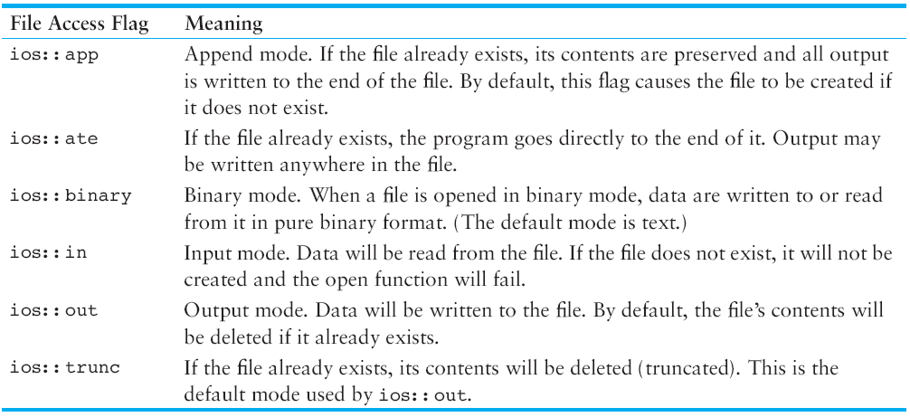
File Access Flags

Slide 6
Example Program
int main()
{
fstream dataFile;//Creating a file variable/object
cout << "Opening file...\n";
dataFile.open("demofile.txt", ios::out); // Open for output
cout << "Now writing data to the file.\n";
dataFile << "Jones\n"; // Write line 1
dataFile << "Smith\n"; // Write line 2
dataFile << "Willis\n"; // Write line 3
dataFile << "Davis\n"; // Write line 4
dataFile.close(); // Close the file
cout << "Done.\n";
return 0;
}

Slide 7
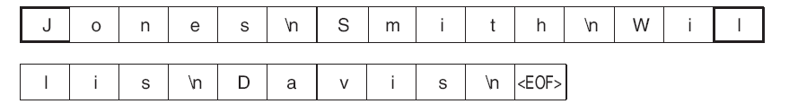

Slide 8
Opening a File with the File Stream Object Definition Statement
fstream dataFile("names.txt", ios::in | ios::out);
ifstream inputFile("info.txt");
ofstream outputFile("addresses.txt");
ofstream dataFile("customers.txt", ios::out|ios::app);

Slide 9
File Output Formatting
Same as you use <iomanip> with cout vartiable
Setw()
Setprecision()
We can use with fstream variables

Slide 10
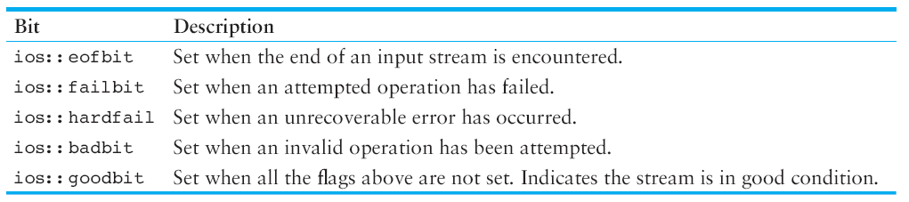
More File handling Functions/Options

Slide 11
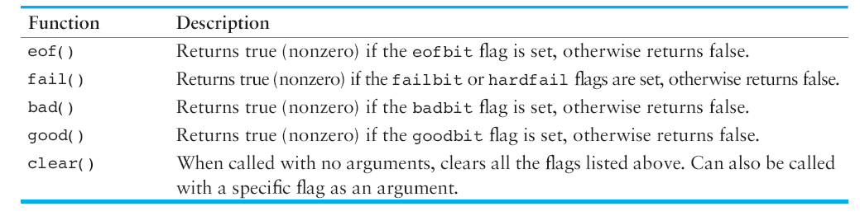
More File handling Functions/Options

Slide 12
The getline() Function
getline(file_variable, string_variable, delimeter);
getline(dataFile, str,'\n');
getline(dataFile, input, '$');

Slide 13
The get() Member Function
Use to read single character from the file.
filevariable.get(Character variable);
inFile.get(ch);

Slide 14
The put() Member Function
filevariable.put(Character variable);
outFile.put(ch);

Slide 15
Working with Multiple Files

Slide 16
Questions(???)
Thanks ☺

Slide 17
References
Chapter 12 Advanced File Operations
Tony gaddis

